Slide 1


WP3 – Data Catalogue Services
Tobias Richter
European Spallation Source ERIC
PaNOSC Review Meeting – June 2020
This project has received funding from the European Union’s Horizon 2020 research and innovation programme under grant agreement No. 823852

Slide 2
Work Package Goals
Open Data – Make Existing and Future Datasets (FAIR)
How: Data Harvesting endpoints and Search API
Target: PaN users and Open Science communities at large
Why: Relevant data is the way into using PaNOSC services
Improve Metadata Quality
Define common PaN Dictionaries (Ontologies) and Metadata Schemas
Increase and improve common use of the NeXus File Format
Connecting Up
Production facilities (beamlines) PaNOSC Service Portal (WP4 & WP6)
EOSC (B2Find, OpenAIRE) Further Facilities – ExPaNDS
Metadata Bodies (RDA, NeXus)

Slide 3
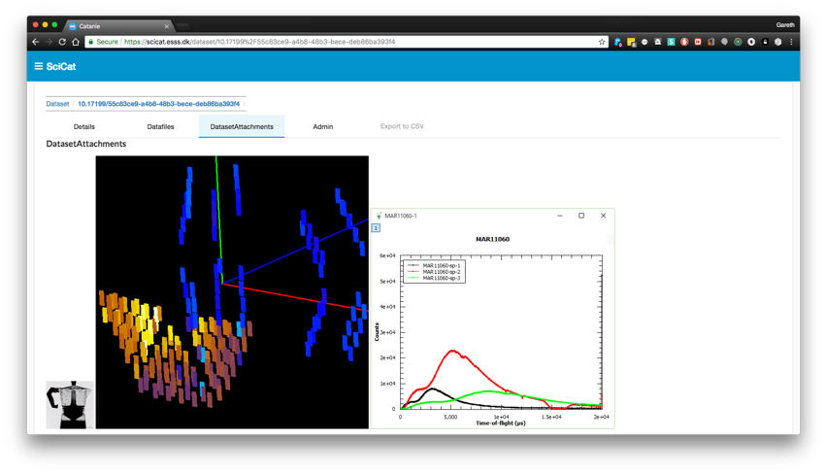



WP3 Data Catalogues – Common Functions
Store reference to raw data and enough metadata to identify the “right” dataset to work with.
Information available often includes:
Proposal Information
Sample Information
Scientific Metadata
Previews
Provenance
Relationship to other data
(derived data)
Relationship to people
Catalogues also Facilitate Data Sharing and Publication

Slide 4
Partner | CERIC | ESS | ELI | ESRF | ILL | XFEL
Catalogue | VUO online storage NOT a catalogue | SciCat | TBD | ICAT | ILL Own | myMdC
URL | https://vuo.elettra.trieste.it | https://scicat.esss.se | --- | https://datahub.esrf.fr | https://data.ill.eu | https://in.xfel.eu/metadata
Login required | Yes | Yes | --- | Yes | Yes | Yes
File formats | NeXus, HDF5, ASCII and many others | NeXus | --- | EDF, SPEC, MCA, CBF, CCD, MCCD, HDF5, NeXus | NeXus and ILL ASCII | HDF5
Database | Oracle | MongoDB | --- | Oracle and MongoDB | Oracle | MySQL and PostgreSQL
Language | Plsql, Python | JavaScript | --- | JAVA and Javascript | PHP | App: Ruby(onRails), Client: Python
Main technologies | WebDAV, Guacamole | Angular | --- | React, NodeJS, EJB, JPA | Symfony, JQuery | Rails
Number of public datasets/files | 0/0 | 181/250,000 | --- | ~540K/157M | ~250K/4M | 0/0
Using OAI-PMH | No | Almost | --- | No | No | No
Minting DOIs | Yes | Yes | --- | Yes | Yes | Yes
Data/embargo policy | Not defined | Embargoed for 3 years | --- | Embargoed for 3 years, ESRF Data Policy | Embargoed for 3 to 5 years, ILL Data Policy | Embargoed for 3 with possible extension to 5 years, XFEL Data Policy
Number of instruments connected to data catalogue | None | 1 | --- | 17 | 54 | 6

Slide 5
Two Routes for Opening Datasets
 | Harvesting | Custom Search
Exposure Method | Push Metadata resides in third party EOSC repository | Pull Metadata stays at facility
Time to Market | Quick (existing solution) | Duration of PaNOSC
Data under embargo | Cannot be exposed | Authentication optional
Richness of Metadata | Generic Schema (Dublin Core initially) | Domain Specific Metadata
Target User Group | Citizen Scientists, General Science Community | Photon and Neutron Facility Users
EOSC Repo
EOSC User
Metadata
Query
Facility 1
Facility 2
Facility 3
Facility 3
Facility 2
Facility 1

Slide 6

EOSC Data Harvesting
Immediate and wide exposure
Low effort to implement
Options:
OAI-PMH (chosen option)
ResourceSync (upgrade option)
JSON-LD/Schema.org
Straightforward mapping from facilities to generic metadata schemas (Dublin Core)
Granularity of data exposed will be coarse and metadata will not be domain specific
However: B2FIND are open to discussing metadata extensions
Status:
OpenAIRE: Registration with re3data completed a while ago by most partners, no data visible until now
B2FIND: Technical issues with parsing metadata being addressed – some data already visible, directly engaged in contact with WP and partners

Slide 7
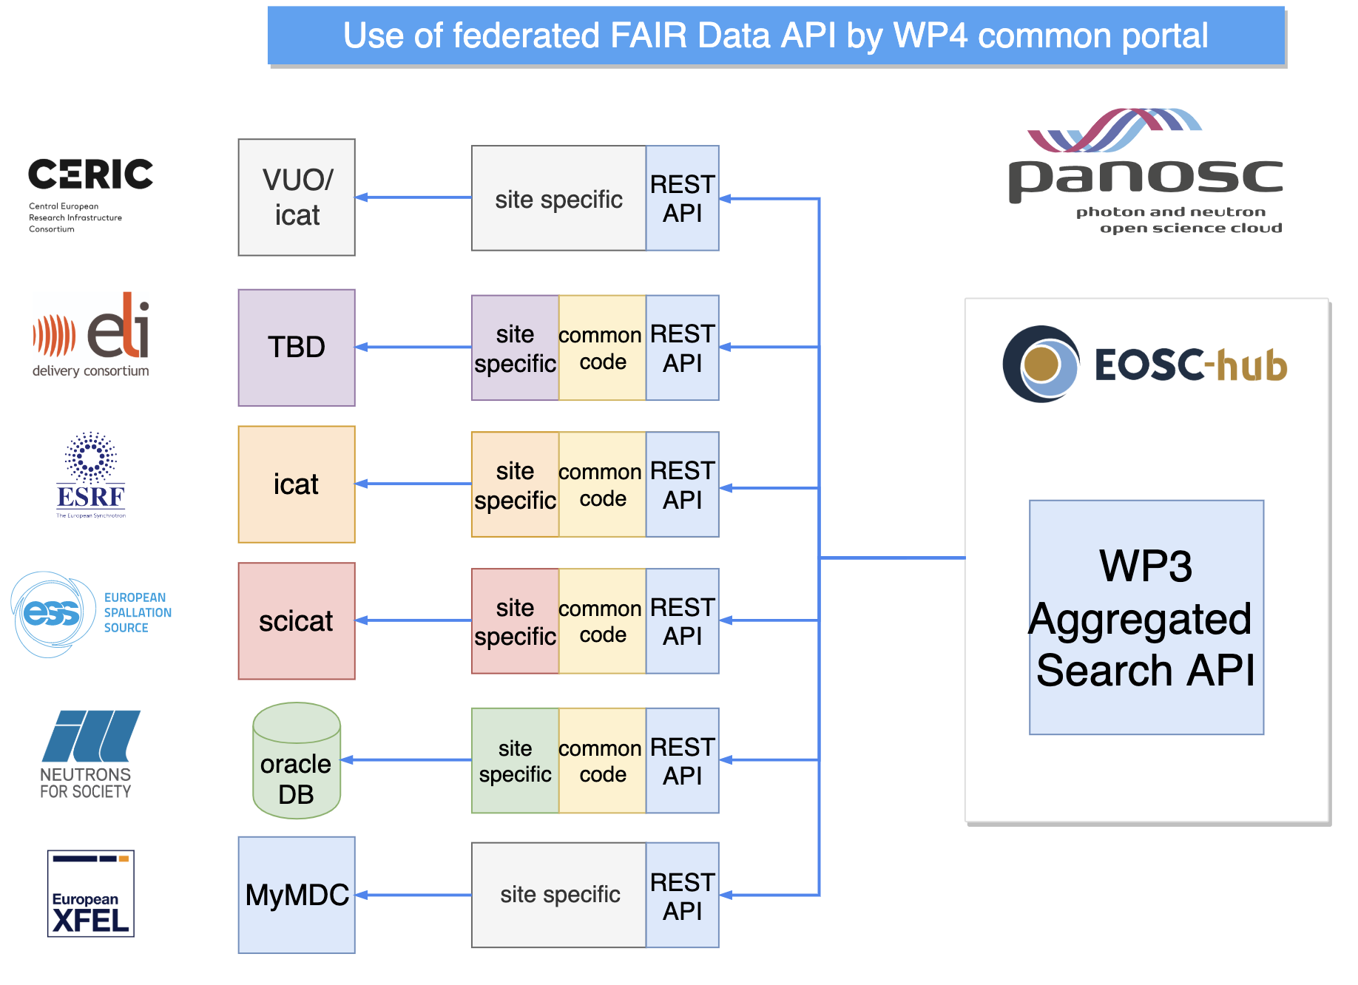
Federated Search API
PaNOSC (and ExPaNDS) specific API with all the domain specific benefits that make the metadata handling attractive to PaN users:
Optional authentication enables handling of embargoed data (PaNOSC data portal)
Metadata content and granularity customisable to be appropriate
All relevant metadata is available for search queries
Use cases and a documented baseline specification exist. Implementation at PaNOSC and ExPaNDS sites to follow.

Slide 8
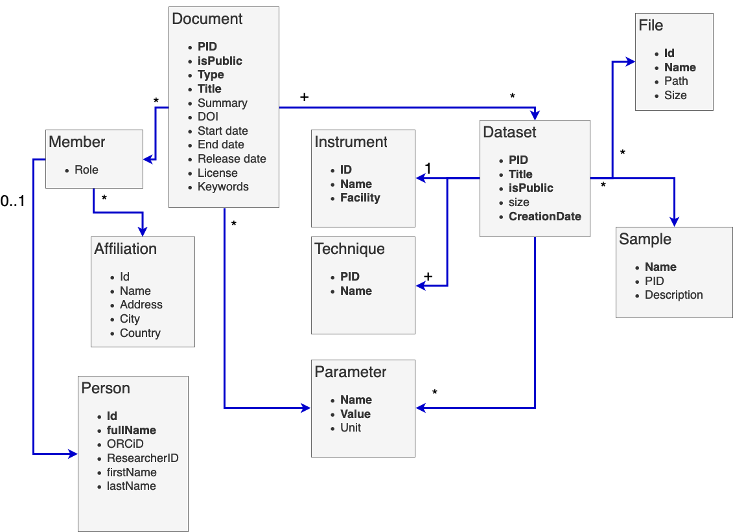
Search API Data Model
REST API operates on a fairly generic set of classes. That simplifies the implementation at different data catalogues.
Domain Specific Value of the API lies in curated dictionaries ontologies and local mappings for:
Experimental Techniques
Parameters for
Sample and Sample Conditions
Experiment Configuration
Supported Units with Conversions
Roles for People

Slide 9
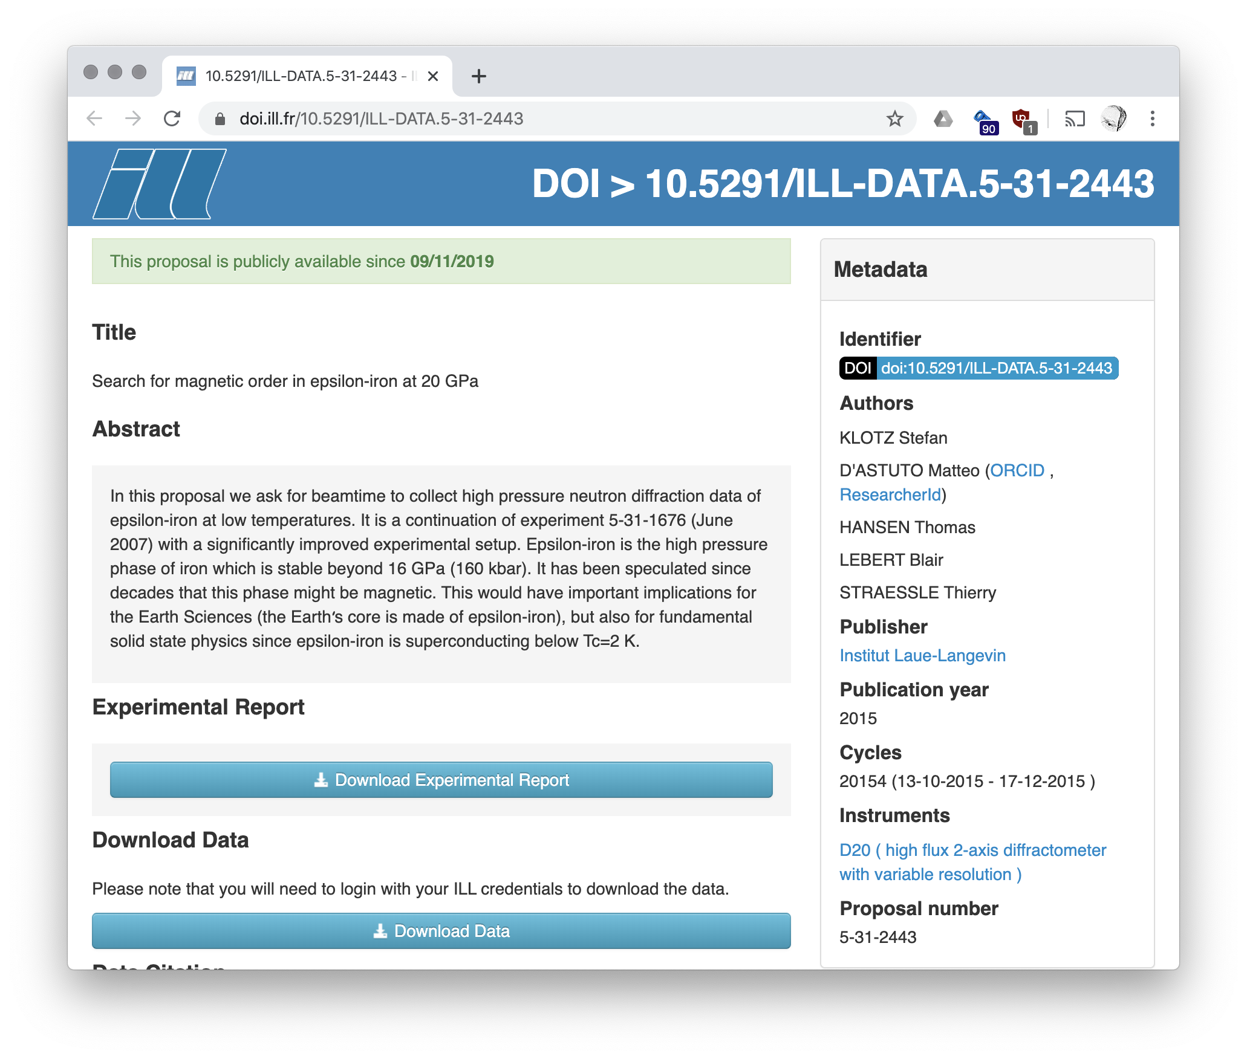
Unit Conversions on the fly
x
Use cases call for units to be reported back to the user as they were specified in the query.
Open data users have a reasonable expectation for the search to work with their terms.
Example:
The proposal on the right should come up when querying for data on Iron:
below -200 ºC (recorded is 2 K)
above 1500 MPa (recorded is 16 GPa)
Conversions need to be handled transparently and search needs to be efficient.
Storing data in the correct original units is valuable information.

Slide 10
NeXus Dissemination
NeXus is the common data format of choice in PaNOSC and beyond. The format defines the names, layout and storage conventions for experimental data in an HDF5 file.
ELI has joined the NeXus advisory committee – half the facilities represented.
The WP ran a series of “Show & Tell” sessions to share the common practises at the partners with respect to storing data and metadata in NeXus. This was a valuable exercise to show that no perfect NeXus files exist and a pragmatic approach to encoding and extracting is acceptable. XFEL has since started using NeXus for new experiments.
The parameters for the search to describe the experiment and sample can be derived from NeXus hierarchies and naming conventions. Together with ExPaNDS we follow two approaches: Formally generating a full set of metadata allowed in NeXus as well as finding the most common parameters recorded in the catalogues or the most commonly requested ones. Both approaches should converge.

Slide 11
Conclusion and Outlook
Open Data
Harvesting making progress. OAI-PMH experience not as seamless as hoped, but should show results in B2FIND soon.
Search API for targeted exposure to our core user community defined. Dissemination ongoing, implementation phase starting up at partners.
Metadata Quality
NeXus dissemination activities have been useful for partners and the WP
Adoption of NeXus increasing, for example at XFEL
Ontology work aligned with ExPaNDS
Reaching Out
EOSC – engaging with B2FIND and trying to establish contact with OpenAIRE
Integration of search into PaNOSC Service Portal
ExPaNDS WP3 onboard with all activities
Integration of production facilities task (mainly ELI and CERIC) starting up

Slide 12
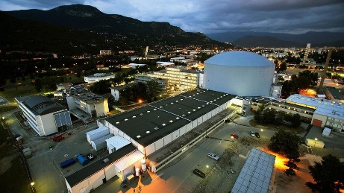
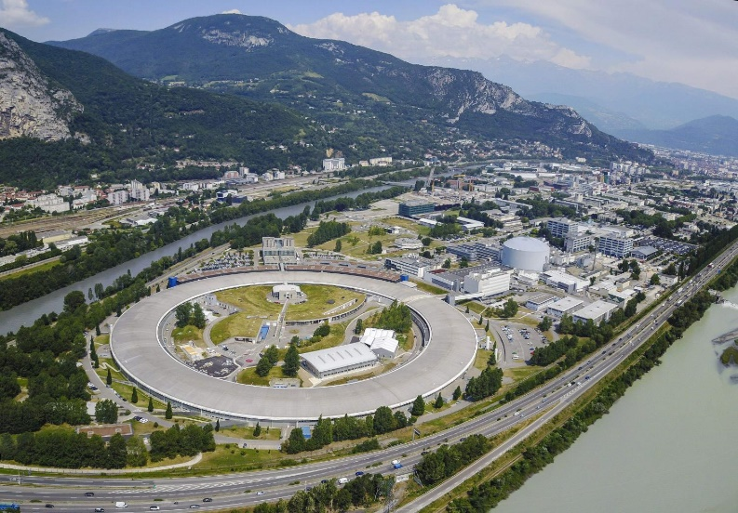
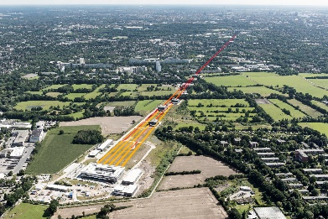










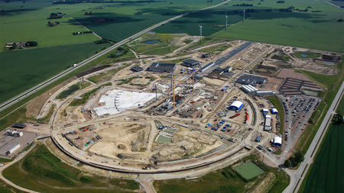




Photon and Neutron Open Science Cloud
Notes:
PEOPLE
Catalogues
Datasets
policies

